Slide 1
Capstone Engagement
Assessment, Analysis, and Hardening of a Vulnerable System
Prepared by: Sarah Cruz

Slide 2
Table of Contents
This document contains the following sections:
01
Network Topology
02
Red Team: Security Assessment
03
Blue Team: Log Analysis and Attack Characterization
Hardening: Proposed Alarms and Mitigation Strategies
04

Slide 3
Network Topology
‹#›

Slide 4
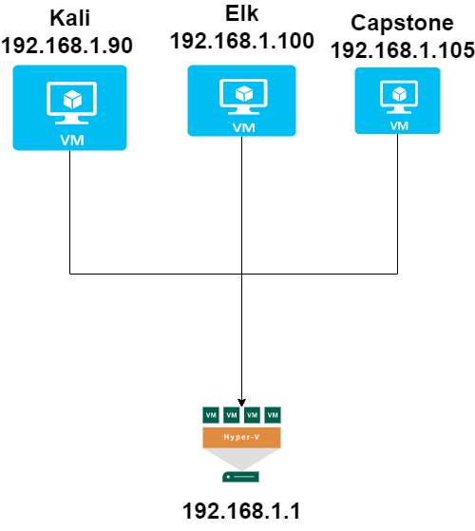
Network Topology
Network
Address Range:192.168.1.1 -192.168.1.105
Netmask: /24
Gateway: 192.168.1.1
Machines
IPv4: 192.168.1.90
OS: Linux
Hostname: Kali
IPv4: 192.168.1.100
OS: Linux
Hostname: Elk
IPv4: 192.168.1.105
OS: Linux
Hostname: Campstone
IPv4:192.168.1.1
OS: Windows
Hostname: Gateway

Slide 5

Red Team
Security Assessment
‹#›

Slide 6
Recon: Describing the Target
Nmap identified the following hosts on the network:
Hostname | IP Address | Role on Network
Kali | 192.168.1.90 | Attacker
Capstone | 192.168.1.105 | Target
Elk | 192.168.1.100 | Monitors the Machines
Hypervisor | 192.168.1.1 | Gateway VM Host

Slide 7
Vulnerability Assessment
The assessment uncovered the following critical vulnerabilities in the target:
Vulnerability | Description | Impact
Brute Force | An attack the consists of systematically checking all possible username and password combinations until the correct one is found. | With the use of the brute force and a common passwords list (rockyou.txt), the password can be easily found.
Open Web Port (80) with public access | LFI allows access into confidential files on a site. | An LFI vulnerability allows attackers to gain access to sensitive credentials
Apache Directory Listing | Allowed attackers to reveal the ip address and the secret folder | Allow attackers to reveal the ip address and the secret folder.
Reverse Shell Backdoor | Allow to send a reverse shell payload on a web server while the firewalls do not detect the payload. | Attackers gained the remote backdoor access to the Capstone web server.

Slide 8
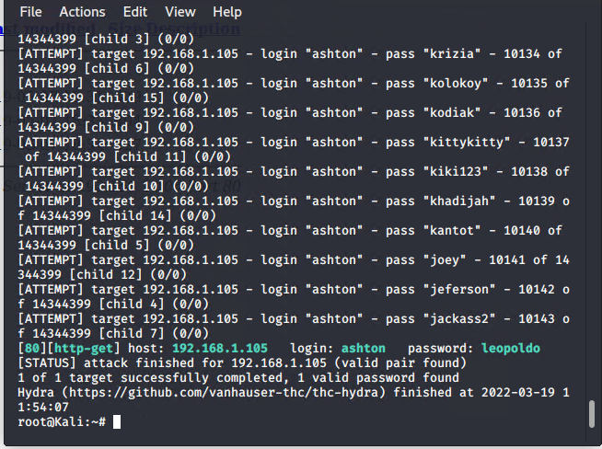
Exploitation: Open Port 80
01
03
Tools & Processes
Used the nmap to scan for any open ports and services in our network.
02
Achievements
Found that IP address 192.168.1.105 had a open port 80, through which we were able to access a directory with important files.

Slide 9
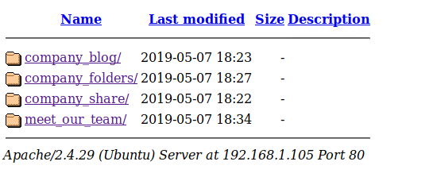
Exploitation: Accessible Files
02
Achievements
Accessing the files gave us intel on which users had to access to what and that where their secret files were located.
01
Tools & Processes
Using the open port 80, we opened a web browser to see if there are anything important to view.
03

Slide 10
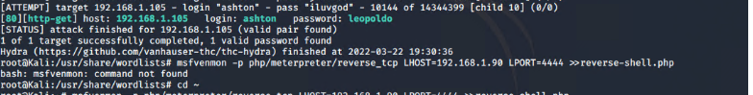
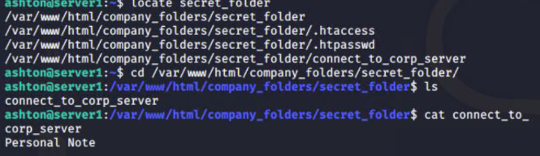
Exploitation: Brute Force Password
03
01
Tools & Processes
Used the tool HYDRA to brute force Ashton’s password using the username: ashton.
02
Achievements
What did the exploit achieve? For example: Did it grant you a user shell, root access, etc.?

Slide 11

Blue Team
Log Analysis and Attack Characterization
‹#›

Slide 12

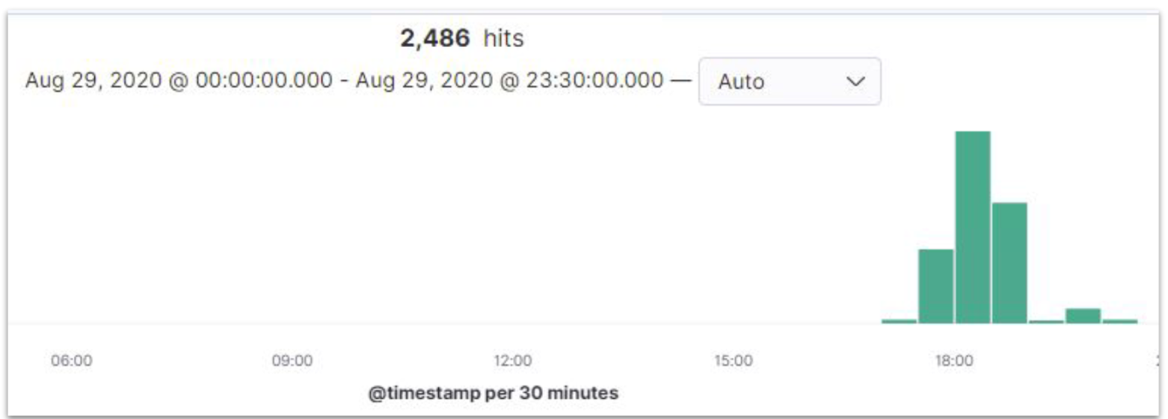
Analysis: Identifying the Port Scan
The port scan began at around 5:30 PM
2486 hits were sent from 192.168.1.90
The nmap ping scan requests to the 443 port, so filtering that, we saw the results below.

Slide 13
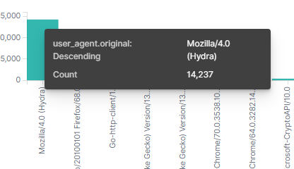
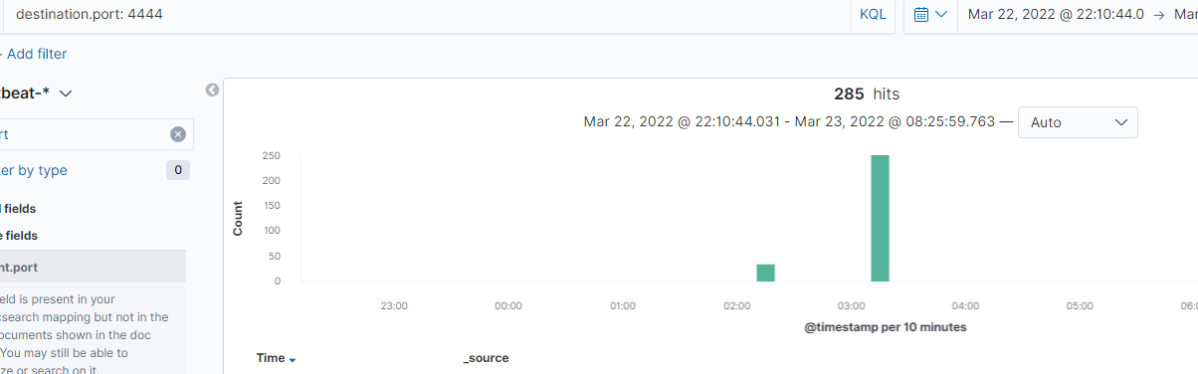
Analysis: Finding the Request for the Hidden Directory
Answer the following questions in bullet points under the screenshot if space allows. Otherwise, add the answers to speaker notes.
14,168 requests for the hidden directory.
File requested was a secret folder hidden within the company folders.
The secret folder contained instructions on how to access the webdav server using Ryan’s account. It also included a hashed password.

Slide 14
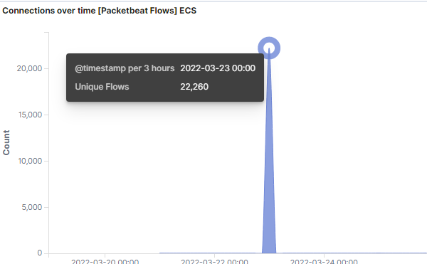
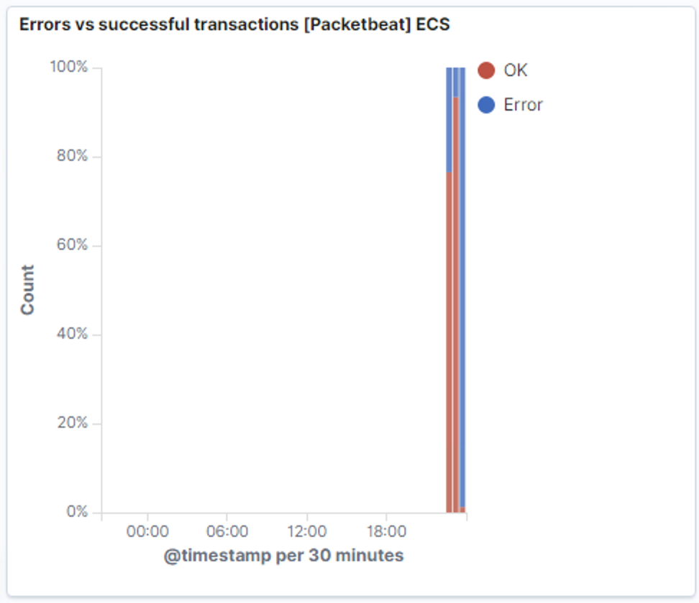
Analysis: Uncovering the Brute Force Attack
There was a spike of 22,260 connections over time.

Slide 15
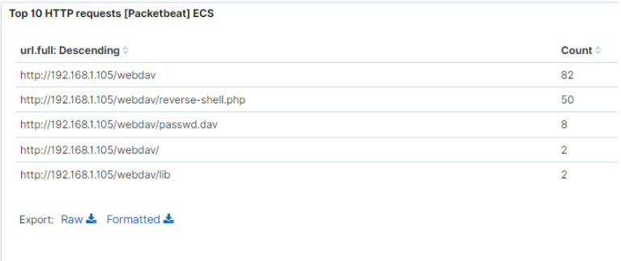
Analysis: Finding the WebDAV Connection
There were 82 requests to the Webdav directory
The shell.php file was requested. This was part of the red teams shell attack to start listening for activity on the victim machine

Slide 16
Blue Team
Proposed Alarms and Mitigation Strategies
‹#›

Slide 17
Mitigation: Blocking the Port Scan
We will set up an alarm for when a firewall detects more than 10 ports scans in a minute or 100 consecutive (ICMP) requests.
Most firewalls and IPSs can detect such scanning and cut it off in real time.
Enable only the traffic you need to access internal hosts and deby everything else.
This goes for standard ports, such as TCP 80 for HTTP and ICMP for ping requests.

Slide 18
Mitigation: Finding the Request for the Hidden Directory
We will set an alert that goes off for any machine that attempts to access this directory or file.
The threshold will be more than 1attempt.
Remove the directory and file from the server.
Terminal rm-r ../company_files (to remove directory)
If needed, move the directory to a safer or offline location.

Slide 19
Mitigation: Preventing Brute Force Attacks
A HTTP 401 Unauthorized client error indicates that the request has to be applied because it lacks valid authentication credentials for the target resource.
I would set an alert if a 401 error is returned in the future.
The threshold that I would set to activate this alarm would be when 10 errors are returned.
Create a policy that locks out accounts for 30 mins after unsuccessful attempts
Create a password policy that requires password complexity.
Compare passwords to commons lists.
Prevent users from reusing historical passwords.
Create a list of blocked IP addresses based on 30 unsuccessful attempts in 6 months.
Make sure a full educated course is required for all staff members

Slide 20
Mitigation: Detecting the WebDAV Connection
Create a list of trusted IP addresses
(review list every 6 months, to allow proper access to each staff member
HTTP GET requests - set an alarm that activates on any IP address trying to access the webDAV directory out of the trusted IP address.
The threshold that I would set to activate this alarm would be when any HTTP PUT request is made.
Create a list of trusted IP addresses and ensure my firewall security policy prevents all other access.
In conjunction with other mitigation strategies, I would ensure that any access to the WebDAV folder is only permitted by users with complex username and password.

Slide 21
Mitigation: Identifying Reverse Shell Uploads
Set an alert for any files being uploaded into the /webDAV folder.
The threshold for the alart to be sent is when one or more attempts are made.
Block all IP addresses other than the list that was created of IP addresses.
(reverse shell can be created over DNS, this action will only limit the risk of reverse shell connections, not eliminate the risk)
Set access to the /webDAV folder to read only to prevent payloads from being uploaded
Ensure only necessary ports are open.

